Slide 1
Sustained Clinical Effects of Single-Dose Intraarticular PCRX-201 Injection in Moderate-to-Severe Osteoarthritis of the Knee
Cecilia Barese,¹ Emily Walsh,² Stanley Cohen,³ Alan Kivitz,⁴ Masato Nakazawa,¹ Mary DiGiorgi,¹ Jonathan Slonin¹
¹Pacira BioSciences, Inc., Tampa, FL; ²Tremont Therapeutics Consulting, Boston, MA; ³Metroplex Clinical Research Center, Dallas, TX; ⁴Altoona Center for Clinical Research, Duncansville, PA

Slide 2
DISCLOSURES
CB, MN, MD, and JS were or are employees of Pacira BioSciences, Inc. and may hold stock or stock options in the company.
EW has received consultancy fees from Pacira BioSciences, Inc.
SC is an Investigator for Pacira BioSciences, Inc.
AK has consulted or been part of speakers bureaus for AbbVie, Amgen, Coval, Ecor1, Flexion, Fresenius Kabi, Gilead, Gruenthal, GSK, Halia, Horizon, Janssen, Prime, Prometheus, Sanofi-Regeneron, Selecta, Synact, Takeda-Nimbus, UCB, and XBiotech; has served on the advisory board of Fresenius Kabi, Gilead, Horizon, Takeda-Nimbus and UCB; has been a speaker for AbbVie, Lilly, Pfizer, and Sanofi-Regeneron; has been a scientific expert for Genzyme; and holds stock/stock options in Pfizer, GSK, Gilead, Novartis, and Amgen.

Slide 3
There is high need for novel OAK treatments given the lack of durable efficacy of current therapies and frequent progression to TKA
Unmet Need in OAK
Opportunity for Novel Therapies
Lack of effective treatment makes OAK a leading cause of chronic pain and disability, affecting ~15 million patients in the United States¹⁻³
SoC largely consists of modalities that have existed for decades, and new MoAs are needed to advance patient care
Oral NSAIDs have unfavorable safety profiles given long-term adverse effects (eg, GI ulcers, serious CV events)⁴
Therapies providing durable pain relief could reduce disability (eg, patients with moderate-to-severe pain miss ~4 times more workdays than those with no or mild pain)¹⁰⁻¹²
Current IA injections offer only short-term relief (eg, 3-6 months),⁵⁻⁸ and ≥12 months durability is considered transformational
Novel treatments that reduce frequency of physician visits and surgery could lower the economic burden of OAK on the healthcare system
Lack of pharmacotherapy causes many patients to progress to TKA at an average cost of ~$20,000 per procedure⁹
CV, cardiovascular; GI, gastrointestinal; IA, Intraarticular, MoA: mechanism of action, NSAID: nonsteroidal anti-inflammatory drug; OAK, osteoarthritis of the knee; SoC, standard of care; TKA, total knee arthroplasty. 1. GBD 2021 Osteoarthritis Collaborators. Lancet Rheumatol. 2023;5(9):e508-e522; 2. Osteoarthritis: A Serious Disease. Mount Laurel, NJ: Osteoarthritis Research Society International; 2016. Available at https://oarsi.org/oarsi-white-paper-oa-serious-disease. Accessed May 1, 2023; 3. Deshpande et al. Arthritis Care Res (Hoboken). 2016;68(12):1743-1750; 4. Vonkeman and van de Laar. Semin Arthritis Rheum. 2008;39(4):294-312; 5. Baron et al. Curr Ther Res Clin Exp. 2018;88:35-46; 6. He et al. Int J Surg. 2017;39:95-103; 7. Saltychev. Am J Phys Med Rehabil. 2020;99(7):617-625; 8. American Academy of Orthopaedic Surgeons Management of Osteoarthritis of the Knee (NonArthroplasty) Evidence-Based Clinical Practice Guideline. https://www.aaos.org/oak3cpg. Published 08/31/2021; 9. Losina et al. Arthritis Care Res (Hoboken). 2015;67(2)203-215; 10. Jackson et al. Adv Ther. 2020;37(9):3985-3999; 11. Beswick et al. BMJ Open. 2012;2(1):e000435; 12. Wylde et al. EFFORT Open Rev. 2018;3(8):461-470.
3

Slide 4
PCRX-201, a locally administered gene therapy with an inducible promotor, enables production of IL-1Ra in the target joint only when it is inflamed
PCRX-201 Components
Key PCRX-201 Strengths
High-capacity, transduction efficient HCAd with no viral coding sequences; carries the genetic code for IL-1Ra (ie, IL-1RA protein)
Avoids Gene Therapy Pitfalls
Adenovirus Vector
PCRX-201 transduces at low doses and does not insert itself into the genome, mitigating safety concerns typically associated with gene therapies
Designed for Long-term Benefit
IL-1 is a known inflammatory cytokine with inhibition tied to the reduction of catabolic processes in the joint that contribute to OAK progression¹
PCRX-201 enables joint cells to produce IL-1Ra, providing sustained levels of the protein to yield long-term therapeutic benefit
IL-1Ra
Protein Production Only As Needed
An NF-κB promotor only turns on IL-1Ra production in the presence of inflammation, mimicking the body’s natural response to inflammation
The inducible promotor allows for localized production of anti-inflammatory IL-1Ra where and when it is most needed, ensuring maintenance of joint homeostasis
Inducible Promoter
IL-1Ra, interleukin-1 receptor antagonist; NF-κB, nuclear factor κB; OAK, osteoarthritis of the knee; HCAd, high-capacity adenovirus.
1. Senter et al. Hum Gene Ther. 2022;33(9-10):541-549.
4

Slide 5
Methods
This open-label phase 1 trial (NCT04119687) enrolled 2 cohorts
Primary endpoints
Safety and biodistribution
Exploratory efficacy endpoints
Patient-reported outcomes
WOMAC pain
WOMAC stiffness
KOOS
Other endpoints
NAbs
Structural assessments (radiograph, MRI)
IL1-RA synovial fluid levels
Inclusion criteria
Adults aged 30-80 years with moderate-to-severe knee OA
K/L grade 2-4
Prior treatment failure of ≥2 other therapies for OA
Baseline WOMAC pain score ≥4.0 and ≤9.0 of 10.0
Doses were assessed in cohort 1 first, followed by expansion with cohort 2
Acetaminophen was the only permitted rescue analgesic
No other analgesics were permitted (other than stable doses of SSRIs, SNRIs, NSRIs, or tricyclics)
PCRX-201 dose levels:
Low: 2.8E9 GC/mL ● Middle: 2.8E10 GC/mL ● High: 2.8E11 GC/mL
Cohort 1: not pretreated
PCRX-201 IA ultrasound-guided injection
Cohort 2: steroid pretreated
IA methylprednisolone 40 mg immediately before PCRX-201 administration
Objective: to investigate the safety and efficacy of a single IA injection of PCRX-201 in participants with moderate-to-severe OAK in a phase 1 trial
Notes:
..

Slide 6
The Median Follow-up of 72 Participants on Study Was 52 Weeks
Participant Flow Diagram
Part 1: SAD
Part 2: Expansion
72 individuals treated
36 per cohort
Median follow-up
Not pretreated - 52 (range, 17-52) weeks
Pretreated - 52 (range, 10-52) weeks
Not pretreated (n=36)
Steroid pretreated (n=36)
Low dose (n=12)
Middle dose (n=16)
High dose (n=8)
Low dose (n=13)
Middle dose (n=15)
High dose (n=8)
n=12 at week 52
n=14 at week 52
n=5 at week 52
n=7 at week 52
n=12 at week 52
n=6 at week 52
Discontinuations by week 52:
Withdrew consent*: n=4
Lost to follow-up: n=3
TEAE: n=1
Discontinuations by week 52:
Withdrew consent†: n=8
Lost to follow-up: n=1
TEAE: n=1
Withdrawn by investigator: n=1
Death‡: n=1
Notes:
..

Slide 7
Demographics and Baseline Characteristics Were Similar Across Cohorts
 | Not pretreated cohort (n=36) | Steroid pretreated cohort (n=36)
Age, median (IQR), y | 62.0 (58.5-67.0) | 67.5 (58.5-71.5)
Female, n (%) | 21 (58.3) | 21 (58.3)
K/L grade, n (%)
2 | 7 (19.4) | 6 (16.7)
3 | 23 (63.9) | 15 (41.7)
4 | 6 (16.7) | 15 (41.7)
WOMAC pain score, mean (SD) | 6.8 (1.3) | 6.8 (1.1)
BMI, mean (SD), kg/m² | 32.1 (4.2) | 31.2 (4.9)
Years since primary diagnosis, mean (SD) | 8.6 (8.8) | 14.6 (10.9)
Unilateral or bilateral OAK, n (%)
Unilateral | 8 (22.2) | 10 (27.8)
Bilateral | 28 (77.8) | 26 (72.2)
Baseline characteristics similar across cohorts
Most are female with a K/L grade of 3-4
Mean baseline WOMAC pain 6.8 in both cohorts
~75% in both cohorts had bilateral OAK
Notes:
..

Slide 8
PCRX-201 Was Safe and Well-Tolerated Across a 100-Fold Range of Vector Doses
No related SAEs reported regardless of pretreatment or dose level
Joint effusion was the most common TEAE, as shown below
A total of 45 joint effusions occurred in 39 participants; of these, 44 effusions were in the index knee and 37 were deemed related to treatment by the investigator
More frequent and more severe in the not pretreated cohort
Similar durations in both cohorts*: range 2-165 days not pretreated, 3-111 days pretreated
Summary of Participants With TEAEs†
 | Not pretreated cohort (n=36) |  |  |  | Steroid pretreated cohort (n=36)
 | Low dose (n=12) | Middle dose (n=16) | High dose (n=8) | Total | Low dose (n=13) | Middle dose (n=15) | High dose (n=8) | Total
Any TEAE | 9 (75.0) | 15 (93.8) | 8 (100) | 32 (88.9) | 11 (84.6) | 13 (86.7) | 8 (100.0) | 32 (88.9)
SAE | 0 | 1 (6.3) | 1 (12.5) | 2 (5.6) | 1 (7.7) | 1 (6.7) | 2 (25.0) | 4 (11.1)
TEAE grade ≥3 | 1 (8.3) | 3 (18.8) | 3 (37.5) | 7 (19.4) | 2 (15.4) | 3 (20.0) | 2 (25.0) | 7 (19.4)
Participants with TEAEs occurring in ≥10% of participants in either cohort
Joint effusion | 6 (50.0) | 10 (62.5) | 8 (100.0) | 24 (66.7) | 5 (38.5) | 5 (33.3) | 5 (62.5) | 15 (41.7)
Arthralgia | 5 (41.7) | 3 (18.8) | 1 (12.5) | 9 (25.0) | 4 (30.8) | 6 (40.0) | 6 (75.0) | 16 (44.4)
Joint swelling | 6 (50.0) | 1 (6.3) | 1 (12.5) | 8 (22.2) | 0 | 2 (13.3) | 0 | 2 (5.6)
Headache | 2 (16.7) | 1 (6.3) | 2 (25.0) | 5 (13.9) | 1 (7.7) | 2 (13.3) | 1 (12.5) | 4 (11.1)
Musculoskeletal pain | 0 | 0 | 0 | 0 | 2 (15.4) | 0 | 2 (25.0) | 4 (11.1)
Notes:
..

Slide 9
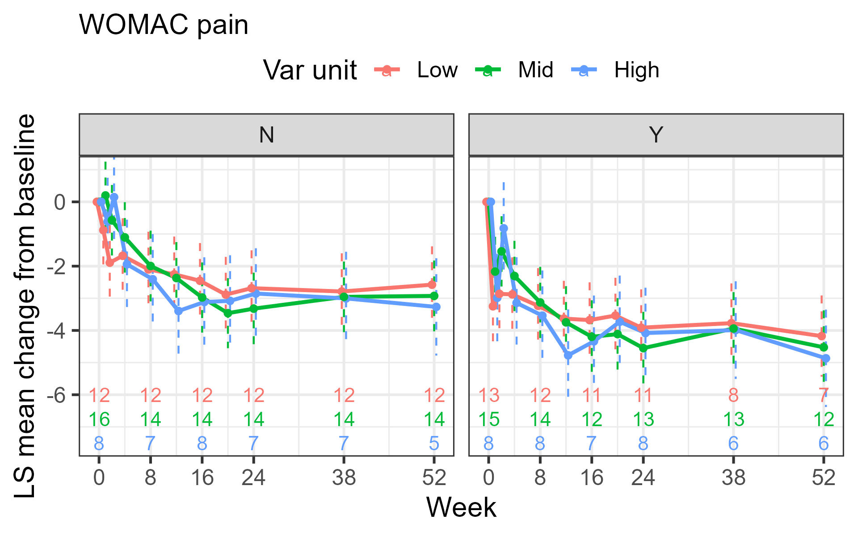
EfficacyꟷWOMAC-A Pain: 50%-75% Sustained Improvement at 52 Weeks
Not pretreated
Steroid pretreated
Considerable improvement compared to baseline in WOMAC-A pain at all dose levels
Trending dose relative in pain reduction, not statistically significant
Improved pain reduction with steroid pretreatment
Similar results seen with % reduction from baseline
A ~50%-75% improvement from baseline across all dose levels was observed with steroid pretreatment
LSM change from baseline (SEM)
WOMAC IMPROVEMENT
Sample size
Week
Cohort
Low
Mid
High

Slide 10
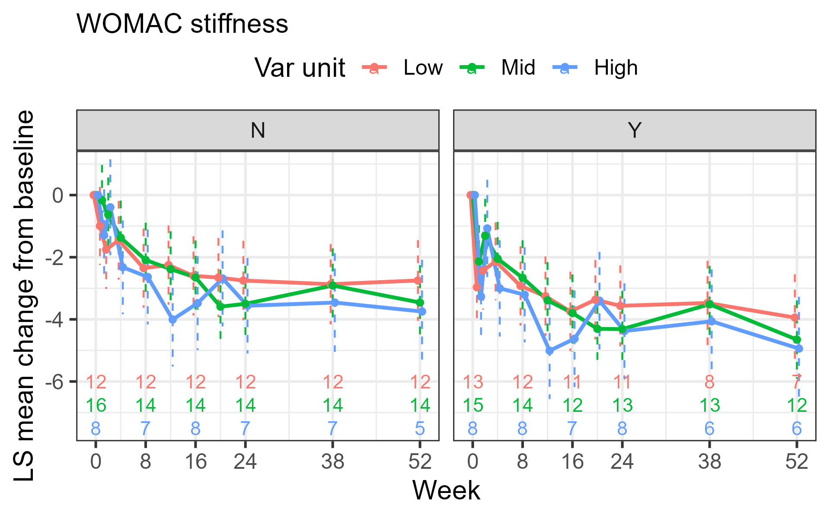
EfficacyꟷWOMAC-B Stiffness: 50%-75% Sustained Improvement at 52 Weeks
Not pretreated
Steroid pretreated
Similar improvement compared to baseline in WOMAC-B stiffness at all dose levels
Trending dose relative in stiffness reduction, not statistically significant
Improved stiffness reduction with steroid pretreatment
Similar results seen with % reduction from baseline
A ~50%-75% improvement from baseline across all dose levels was observed with steroid pretreatment
LSM change from baseline (SEM)
WOMAC IMPROVEMENT
Sample size
Week
Cohort
Low
Mid
High

Slide 11
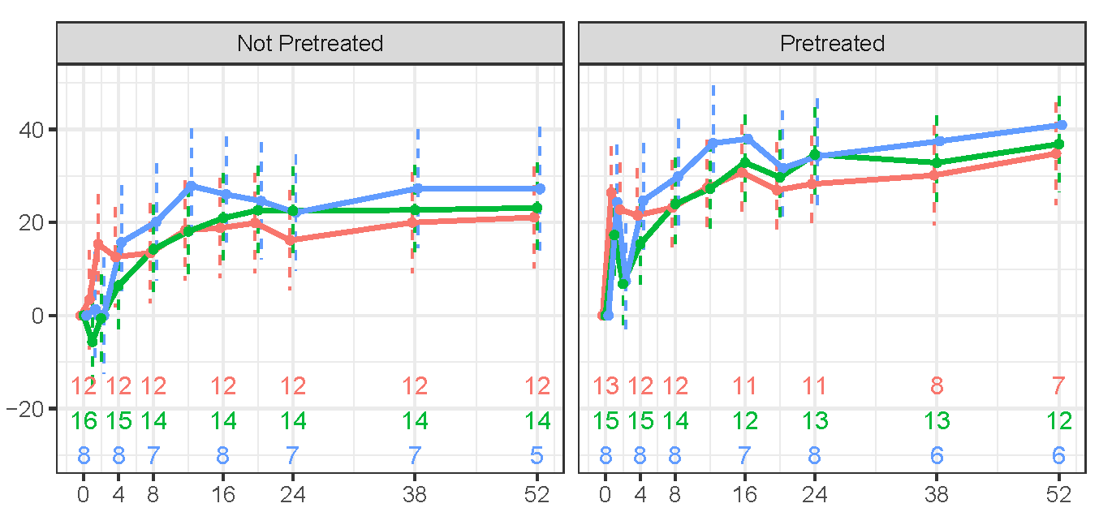
EfficacyꟷKOOS Daily Living: 20- to 40-Point Sustained Improvement at 52 Weeks
Favorable improvements in KOOS activities of daily living scores at all dose levels
Trending dose relative but not statistically significant
Greater improvement in steroid pretreated cohort
Not pretreated
Steroid pretreated
KOOS IMPROVEMENT
LSM change from baseline (SEM)
Sample size
Week
Cohort
Low
Mid
High

Slide 12
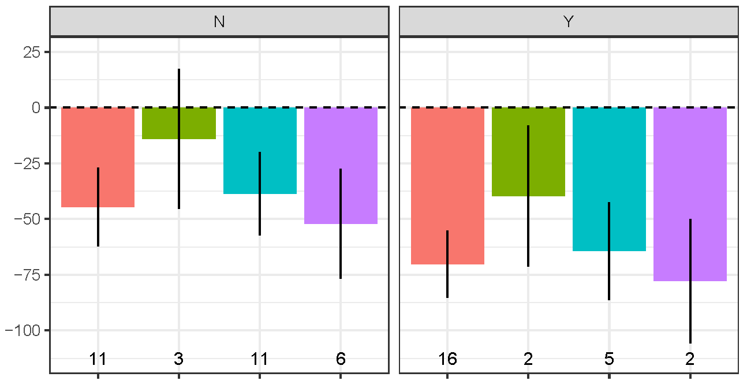
Neutralizing Antibodies: No Impact of Baseline NAbs on Safety or Efficacy Regardless of Baseline NAb titer
Not pretreated
Steroid pretreated
Baseline NAb positivity was 59%-64% in not pretreated cohorts versus 13%-64% in steroid pretreated cohorts*
No impact of baseline NAbs on WOMAC-A or WOMAC-B (not shown) regardless of baseline NAb titer
No impact of baseline NAbs on effusion incidence (not shown)
LSM % change from baseline
in WOMAC-A
WOMAC IMPROVEMENT
Sample size
NAb baseline titer
0
1-499
500-5000
>5000

Slide 13
Payload Expression: Synovial Fluid IL-1RA Levels Are Elevated 1.4- to 132.9-fold After PCRX-201 Dosing
 | Dose Cohort | Baseline | After dose* | Fold increase over baseline
Participant A | Low Not Pretreated | 259.59 | 372.26 | 1.4
Participant B | Low Not Pretreated | 1006.64 | 49744.08 | 49.4
Participant C | Mid Not Pretreated | 249.79 | 1104.32 | 4.4
Participant D | Mid Not Pretreated | 517.22 | 68759.42† | 132.9
Paired sample analysis offers insights
All participants with baseline and posttreatment paired samples showed IL-1RA expression enhancement (N=4)
Caveats
Expressed protein is identical to endogenous
NF-kB responsive promoter means expression depends on local inflammatory state
IL-1RA, IL-1 receptor antagonist; NF-κB, nuclear factor κB. *All Week 4 except as noted. †Sample taken at week 1.

Slide 14
Conclusions
A single intraarticular injection of PCRX-201 had acceptable safety and sustained efficacy at all dose levels across 100-fold range up to 52 weeks at time of cutoff
The steroid pretreated cohort exhibited fewer joint effusions and a ~50%-75% reduction from baseline in WOMAC/pain stiffness scores as well as greater improvements in function than the not pretreated cohort, suggesting pretreatment has a favorable impact on efficacy and tolerability and meaningful improvements in function
Baseline anti-Ad5 NAbs do not appear to impact the incidence of TEAEs or improvement in WOMAC measures at any titer observed (up to >30,000)
Dose-trending but no statistical dose response across a 100-fold range of vector suggests a wide range of options for dose selection
Compelling phase 1 data supported PCRX-201 as the first gene therapy product candidate to receive Regenerative Medicine Advance Therapy designation in OAK from the FDA¹
FDA, Food and Drug Administration; KOOS, Knee Injury and Osteoarthritis Outcome Score; NAb, neutralizing antibody; OAK, osteoarthritis of the knee; TEAE, treatment-emergent adverse event; WOMAC, Western Ontario and McMaster Universities Osteoarthritis Index.
1. Pacira BioSciences. 2024. https://investor.pacira.com/node/17121/pdf.

Slide 15
Future Directions
Deeper understanding of any NAb impact on iterative and/or contralateral dosing
Deeper mechanistic understanding of durability
Additional dose-ranging to select the doses for pivotal studies
Longer-term follow-up: 2-year long-term data now being analyzed to understand durability of pain and function improvement and impact on structural disease progression
NAb, neutralizing antibody.

Slide 16
THANK YOU

